Slide 1

Linguistic Chatbot vs ChatGPT
Group - 1 - COMP5313 - Artificial Intelligence
Conversational Contest - Positional Paper
Supervised by - Dr. Sabah Mohammed

Slide 2
Team Members
Parth Bhanushali 1226290
Arvind Boominathan 1212299
Renjith E Chacko 1213107
Usman Fakhar 1221662
Moksha Gandhi 1230497
Rithika Gopi 1220895
Gaeul Han 0865953
Anik Dutta 1191528

Slide 3
TABLE OF CONTENTS
01
02
03
04
05
06
Introduction
Literature Review
Methodology
Code
Comparison of Output
References

Slide 4
INTRODUCTION
Among the plethora of chatbots, two distinct categories have emerged: Linguistic Chatbots and ChatGPT, which represent different approaches to conversational AI
The Linguistic Chatbot category encompasses systems designed with structured dialogue trees or rule-based approaches, where responses are predefined based on specific keywords or patterns in user input.
On the other hand, ChatGPT, a product of OpenAI, represents a paradigm shift by employing large-scale deep learning models, such as GPT (Generative Pre-trained Transformer), to generate contextually relevant responses without explicit rule-based programming.

Slide 5
INTRODUCTION CONTD.
This presentation delves into the comparison between Linguistic Chatbots and ChatGPT in the specialized domain of culinary arts, focusing on a chef chatbot scenario. The scenario of a chef chatbot presents an intriguing context to evaluate the capabilities, limitations, and user experience of both types of chatbots.
The primary objective of this presentation is to analyze and compare the performance of Linguistic Chatbots and ChatGPT in assisting users with culinary inquiries and tasks. By evaluating aspects such as response accuracy, naturalness, and user satisfaction, this study aims to provide insights into the strengths and weaknesses of each approach in the context of a chef chatbot.

Slide 6
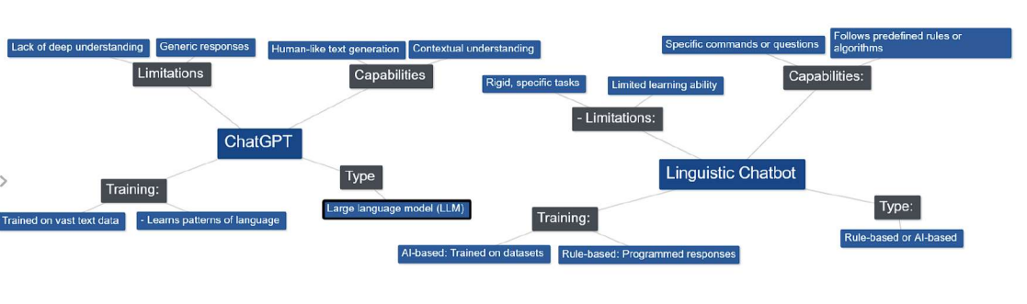
MIND MAP

Slide 7
LITERATURE REVIEW
Application of NLP:Design of Chatbot for New Research Scholars (Dr. Sunanda Mulik a , Dr. Poonam Sawant b , Dr. Vaishali Bhosale c)
Discusses the development of a chatbot to support new researchers in the field of Natural Language Processing (NLP).
Uses the Keras sequential model and the Adagrad optimizer for high accuracy.
Includes a spell-checking feature to enhance the accuracy of user input, improving the user experience.
Identifies several limitations of the current model, including the lack of spelling suggestions, limited response flexibility, and the fact that it is text-based and not available on mobile platforms or messenger platforms.
Suggests that future research should focus on addressing these limitations.

Slide 8
LITERATURE REVIEW
A Survey of Chatbot Systems through a Loebner Prize Competition (Luka Bradeško and Dunja Mladenić)
Reviews and compares the technologies used by chatbots that have participated in the Loebner Prize Competition, a formal instantiation of the Turing Test.
Discusses the evolution of chatbot technologies from simple pattern matching systems to more complex approaches incorporating ontologies and knowledge bases for computer reasoning.
Discusses the use of language tricks by chatbots to enhance their conversational realism.
Notes that existing chatbots still face challenges in maintaining context and comprehending human inputs and responses.

Slide 9

WORKING
The user interacts with the chatbot and asks questions on recipes needed and the chatbot provides responses on the ingredients, and the recipe itself for the user to follow.

Slide 10
METHODOLOGY
Data Collection
Compiled a dataset of culinary-related questions, queries, and commands from various sources.
Ensured diversity in the types of queries for a comprehensive evaluation of the chatbots’ capabilities.
Experimental Setup
Developed a Linguistic Chatbot using a rule-based approach with responses predefined based on patterns in user input.
Utilized OpenAI’s ChatGPT model, fine-tuned on the culinary dataset to enhance its proficiency in generating contextually relevant responses to culinary inquiries.
Evaluation Metrics
Assessed Response Accuracy based on the relevance and correctness of the information provided in response to the given input.
Evaluated Functionality and Use Case, and Customization and Adaptability.

Slide 11
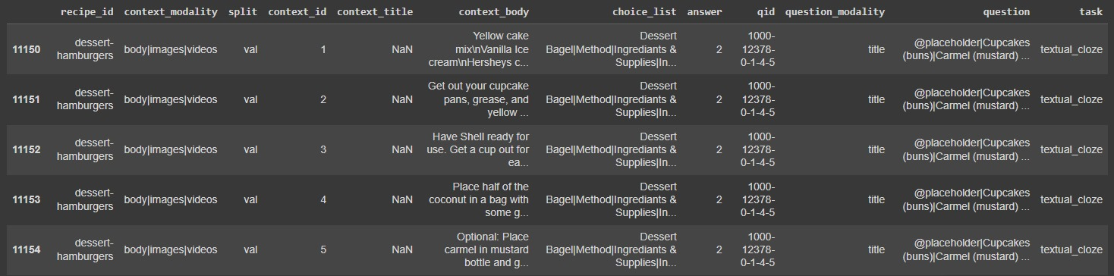
DATASET DESCRIPTION
The RecipeQA dataset comprises 36,786 question-answer pairs that are automatically generated from around 19,779 distinct cooking recipes. Each recipe contains a variable number of steps, each with textual components. Specifically, every step in a recipe is associated with both a ‘title’ and a ‘description’. These elements represent different modalities of the data.

Slide 12

THE CODING

Slide 13
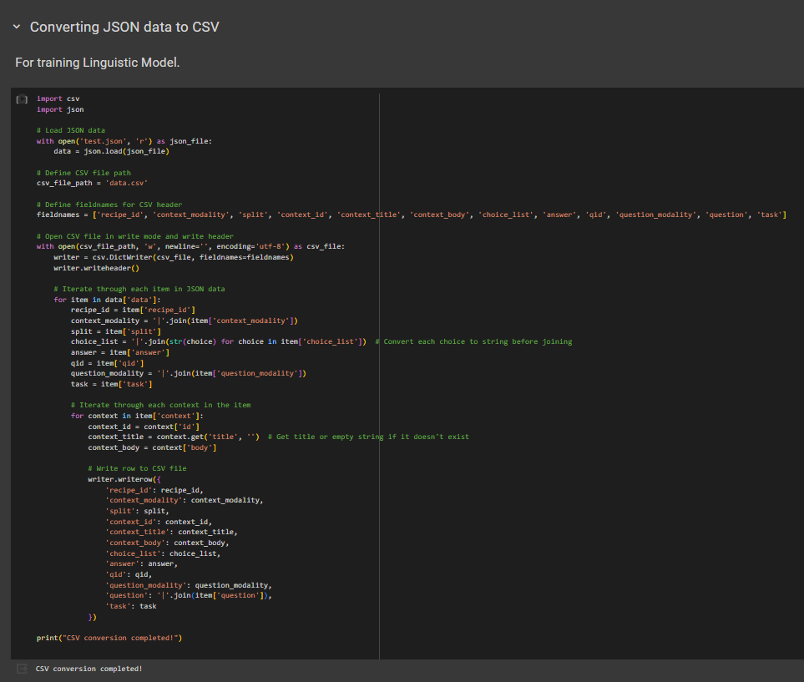
CODE
The data is read from a JSON file, and writes it into a CSV file. This is useful for converting data from JSON format to CSV format. The script is designed to work with a specific structure of JSON data, where each object in the JSON file corresponds to a row in the resulting CSV file, and the keys of the JSON objects correspond to the columns.

Slide 14
CODE
The data is read from a JSON file, and writes it into a CSV file. This is useful for converting data from JSON format to CSV format. The script is designed to work with a specific structure of JSON data, where each object in the JSON file corresponds to a row in the resulting CSV file, and the keys of the JSON objects correspond to the columns.

Slide 15
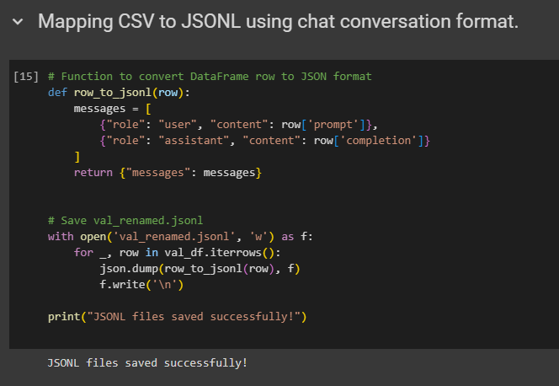
CODE
The data from a CSV file is read and converted into a structured JSONL format that mimics a chat conversation, and then writes this data into a JSONL file. This is useful for transforming structured data into a format that can be used for training chatbot models.

Slide 16
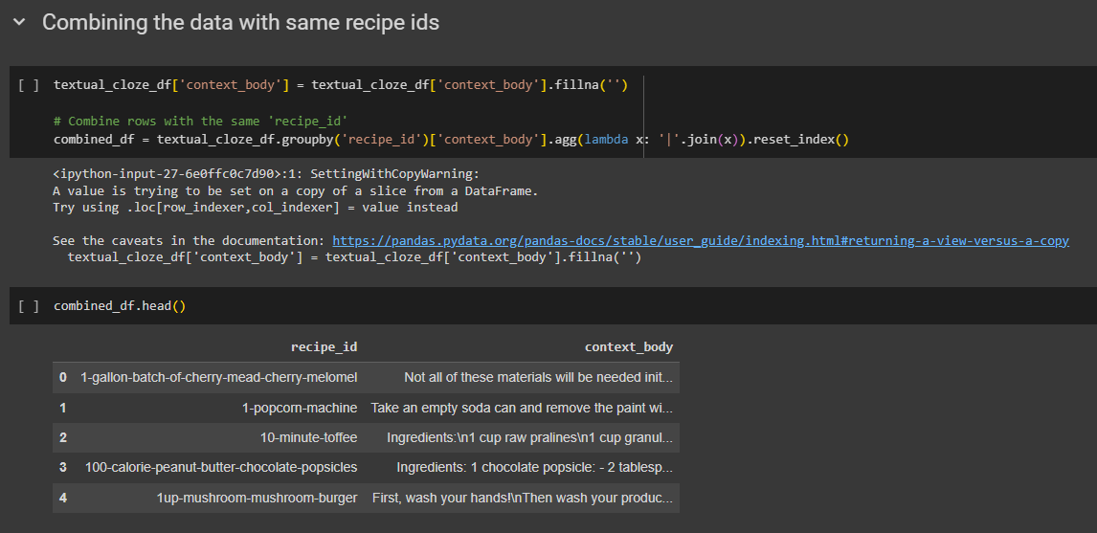
CODE
The images are read from a CSV file and processed by combining rows with the same “recipe_id”, handles missing values, and displays a warning if an attempt is made to set a value on a copy of a slice from the DataFrame.

Slide 17
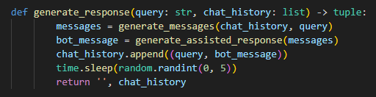
CODE
The function generate_response() takes a query and chat history as inputs, generates a bot response, appends the query and response to the chat history, waits for a random time between 0 to 5 seconds, and then returns the updated chat history. This function is typically used in chatbot systems to simulate real-time conversation dynamics.

Slide 18
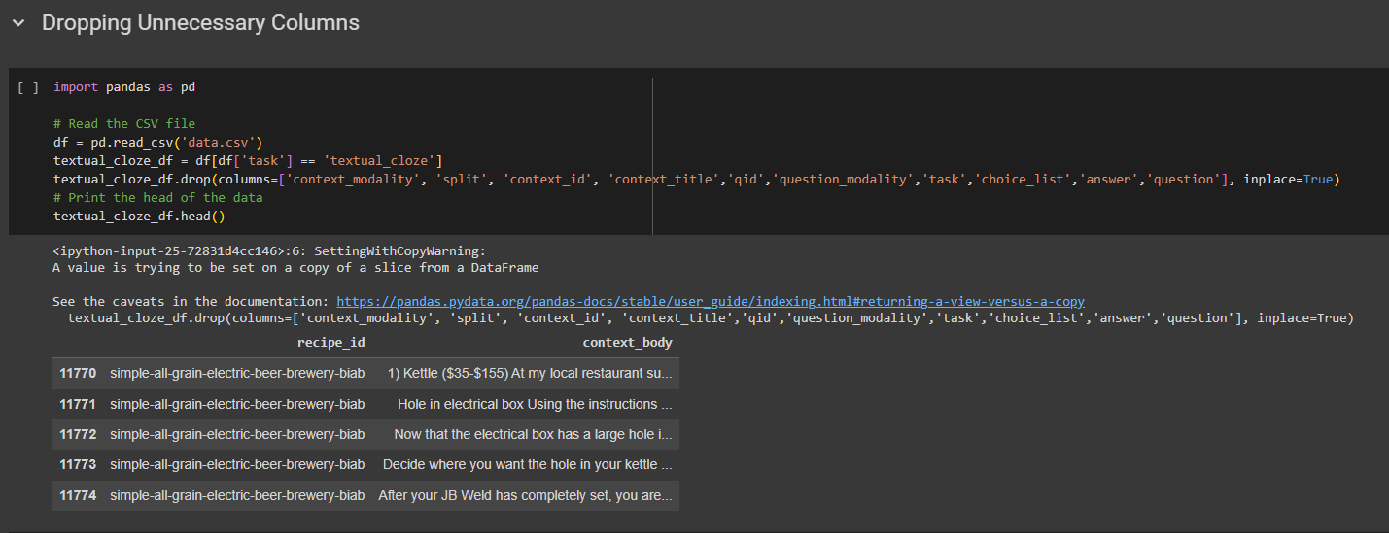
CODE
Python is used for data cleaning. It drops unnecessary columns from a DataFrame using the pandas library. This is a common operation in data preprocessing to remove irrelevant data and reduce the dimensionality of the dataset.

Slide 19
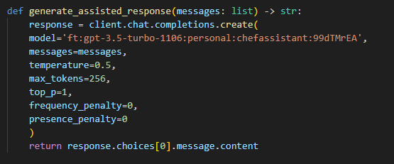
CODE
The generate_assisted_response() function takes a list of messages as inputs, generates a bot response using the OpenAI GPT-3.5 Turbo model, and returns the bot response.

Slide 20
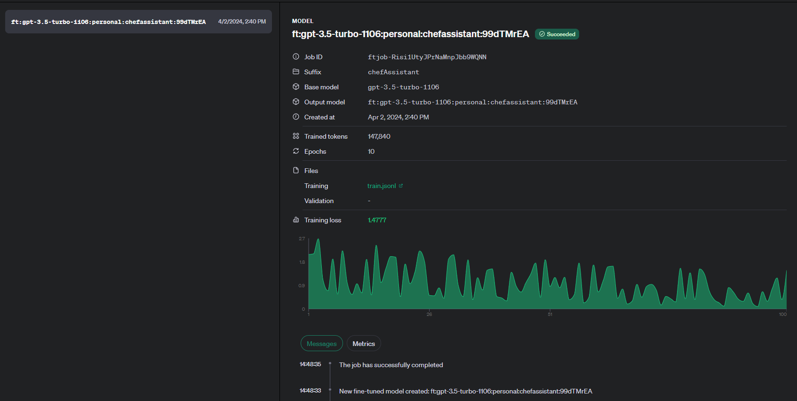
CODE
The model is fine-tuned using OpenAI Dashboard and the training is done on the JSON file.

Slide 21
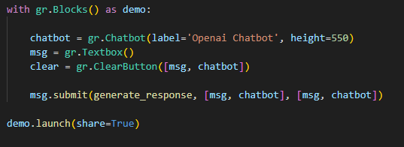
CODE
The code creates an interactive chatbot interface. It includes a text box and a clear button for user input. When the user submits their input, the script processes it through a function called ‘generate_response’ and displays the response on the chatbot interface. This demonstrates how user interfaces can be integrated with backend processing in a simple and effective manner.

Slide 22
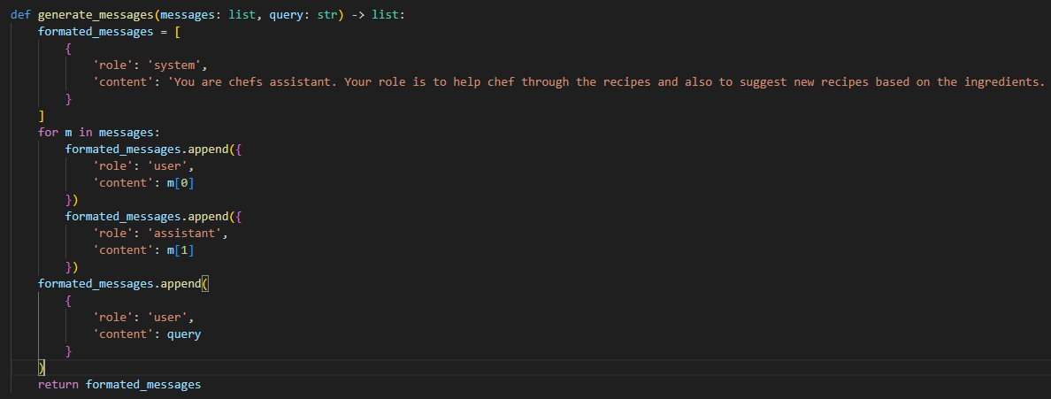
CODE
This function takes a list of messages and a query string as input, and returns a formatted list of messages. Each message is a dictionary with two keys: ‘role’ and ‘content’. The ‘role’ can be ‘system’, ‘user’, or ‘assistant’, and ‘content’ is the corresponding message. The function starts with a system message, then alternates between user and assistant messages for each message in the input list, and ends with a user message containing the query.

Slide 23
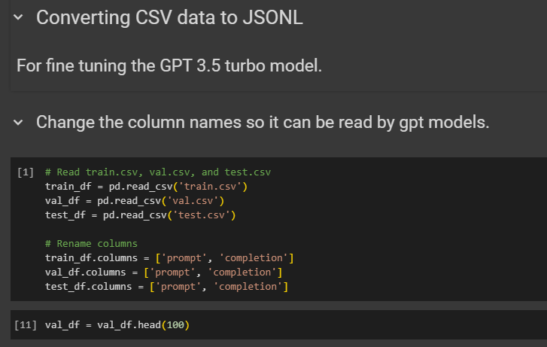
CODE
The Python code reads a CSV file, drops unnecessary columns, renames the remaining columns, and then saves the cleaned data as a JSONL file.

Slide 24
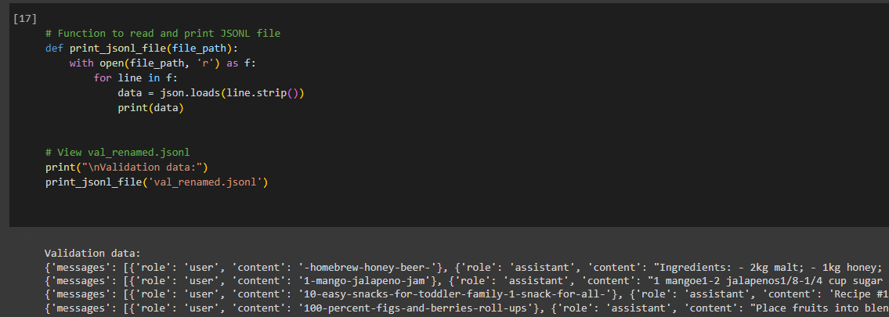
CODE
The JSONL file is printed to show the format of the file and the contents in the dataset

Slide 25
LINGUISTIC CHATBOT

Slide 26
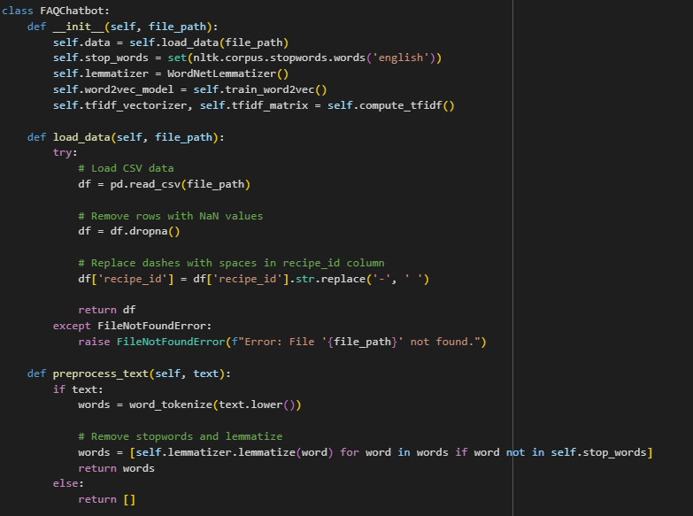
CODE
preprocess_text() tokenizes, converts to lowercase, removes stop words, and lemmatizes using WordNet. It improves text quality by standardizing format, removing irrelevant words, and reducing vocabulary. It returns an empty list if given an empty string.

Slide 27
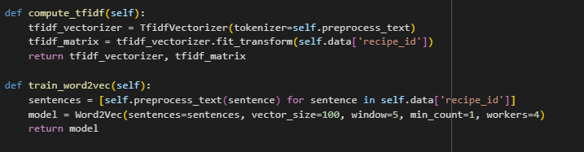
CODE
This code defines two functions: compute_tfidf and train_word2vec. The compute_tfidf function calculates the Term Frequency-Inverse Document Frequency (TF-IDF) matrix of a given text data using the TfidfVectorizer class.
The train_word2vec function trains a Word2Vec model on preprocessed sentences with specific parameters like vector size, window size, minimum count, and number of workers. These functions are commonly used in natural language processing tasks.

Slide 28
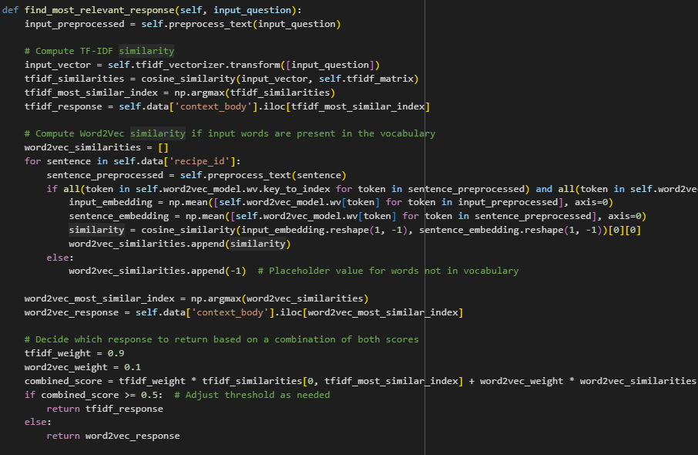
CODE
This code is a function named find_most_relevant_response. It processes the text of a question, computes TF-IDF and Word2Vec similarities between the input and existing data, and returns the most relevant response based on a combination of both similarity scores. This function is used to improve the accuracy of finding the most relevant response to a given input question.

Slide 29
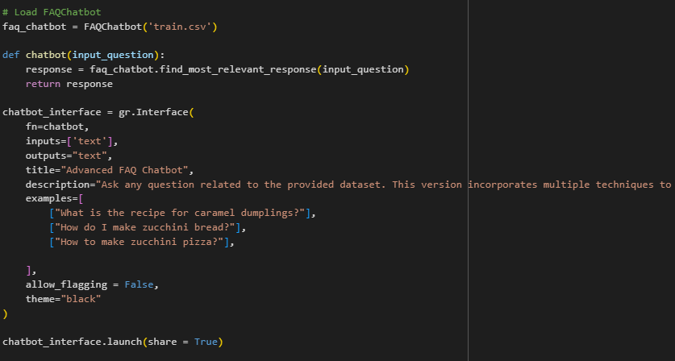
CODE
The code defines a function named “chatbot” that takes a question as input.
It returns the most relevant response from a preloaded CSV file containing FAQs.
The Gradio interface is configured to take text input and has examples of questions related to recipes.

Slide 30
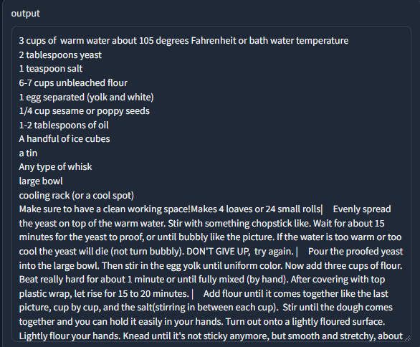
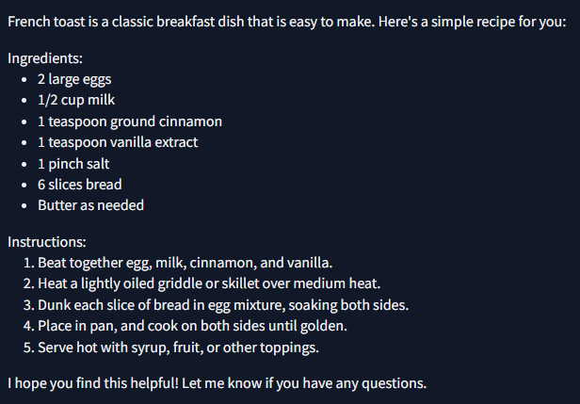
COMPARISON OF OUTPUT
Prompt: How to make french toast?
Linguistic Chatbot
ChatGPT API

Slide 31
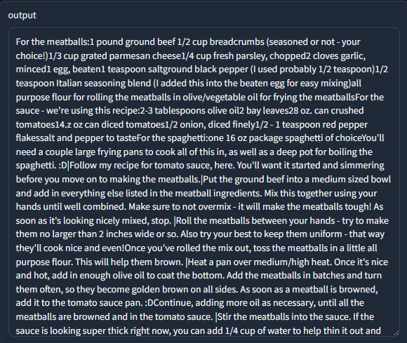
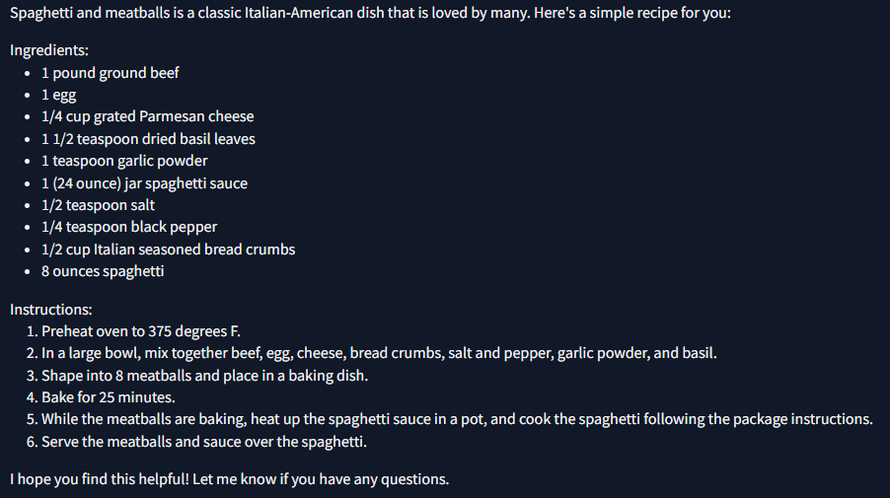
COMPARISON OF OUTPUT
Prompt: Give me recipe for spaghetti and meatballs
Linguistic Chatbot
ChatGPT API

Slide 32
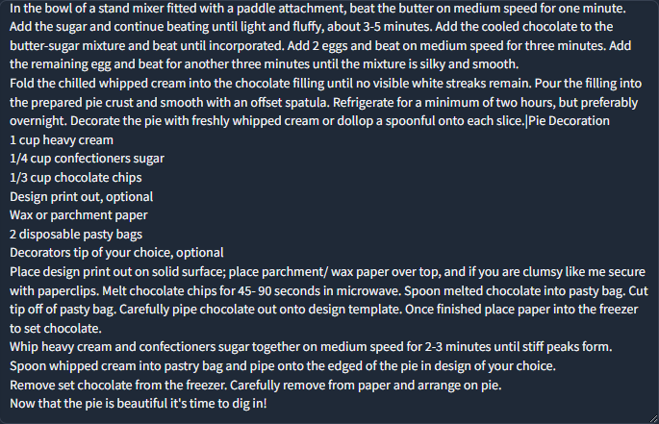
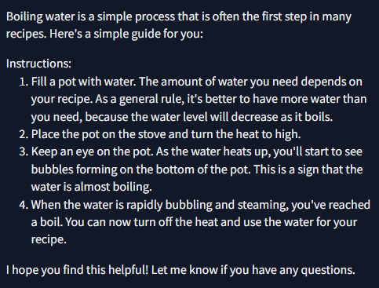
COMPARISON OF OUTPUT
Prompt: How to boil water?
Linguistic Chatbot
ChatGPT API

Slide 33
ARGUMENTS AND COUNTERARGUMENTS
Linguistic Chatbot:
Pros: It may provide more focused and accurate responses within its domain of expertise, providing recipes. It allows for more control over the training data and model architecture.
Cons: Limited scalability and adaptability. The model will not be able to answer questions not present in the dataset.
ChatGPT Chatbot:
Pros: Offers broader capabilities and can handle a wide range of queries beyond recipes. Provides high-quality, contextually relevant responses. Requires minimal setup and maintenance.
Cons: Reliance on external APIs introduces latency (6 seconds on average) and dependency issues. Limited control over model behavior and responses.

Slide 34
MEASURES USED TO COMPARE
Response Quality:
The quality of responses generated by both chatbots is crucial.
The linguistic chatbot's responses may be limited by the dataset it was trained on, potentially leading to inaccuracies or irrelevant answers.
The ChatGPT chatbot, leveraging the state-of-the-art language model GPT-3.5 Turbo, generally produces high-quality and contextually relevant responses due to its extensive pre-training on diverse text data.
Functionality and Use Case:
The Linguistic chatbot (implemented using TF-IDF and Word2Vec) is designed to provide responses based on a dataset of frequently asked questions (FAQs) about recipes. It uses text similarity techniques to find the most relevant response to a user query.
The ChatGPT chatbot (powered by OpenAI's GPT-3.5 Turbo model) generates responses based on a user query and the context of previous interactions. It is a more general-purpose chatbot capable of understanding and generating human-like text across various domains

Slide 35
MEASURES USED TO COMPARE
Customization and Adaptability:
The Linguistic chatbot may require manual adjustments and retraining to adapt to new questions or topics not covered in the original dataset.
The ChatGPT chatbot is more adaptable and can generate responses across a wide range of topics without the need for explicit training or customization.
Ease of Implementation:
Implementing the Linguistic chatbot involves preprocessing the dataset, training similarity models, and integrating them into the chatbot application.
The ChatGPT chatbot, relying on the OpenAI API, requires minimal setup and can be easily integrated into applications with API access.

Slide 36
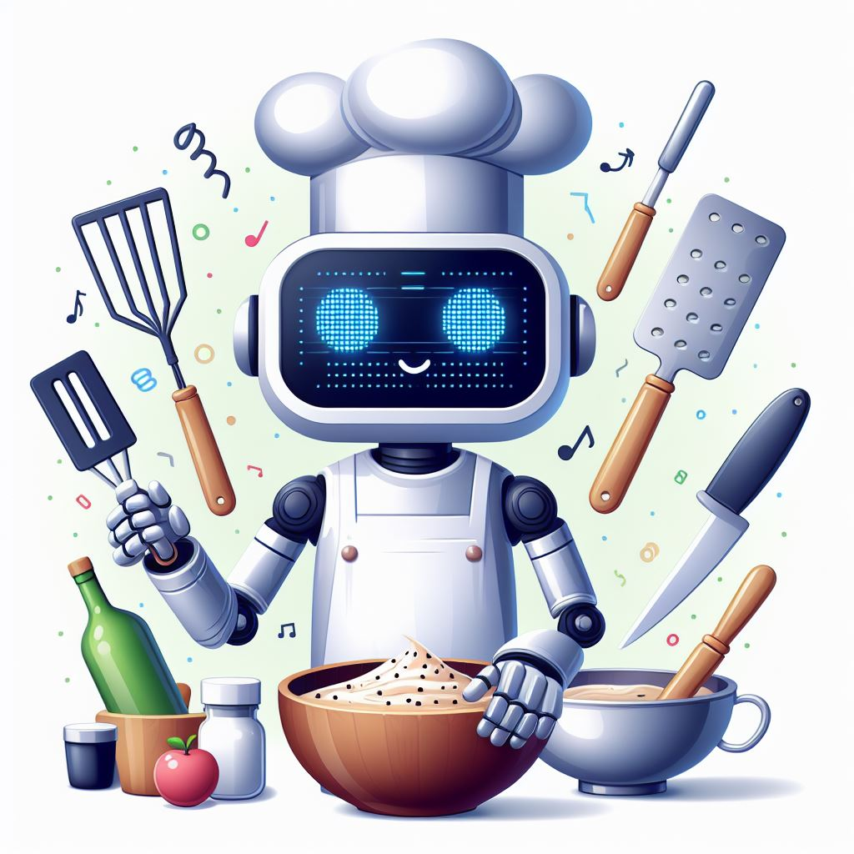
CONCLUSION
Based on the previously mentioned metrics, it can be concluded that the ChatGPT chatbot, which utilizes OpenAI's GPT-3.5 Turbo model, is the better choice in most cases, due to its adaptability, high level of response, and simplicity of use.
However, the linguistic chatbot might be useful in some use scenarios where the company has gathered a wide dataset of various responses, and they do not wish to be held liable for information present in the document.

Slide 37
REFERENCES
Zhao, Liang, En Yu, Zheng Ge, Jinrong Yang, Haoran Wei, Hongyu Zhou, Jianjian Sun et al. "Chatspot: Bootstrapping multimodal llms via precise referring instruction tuning." arXiv preprint arXiv:2307.09474 (2023).
Perera, Pethigamage, and Madhushan Lankathilake. "Preparing to revolutionize education with the multi-model GenAI tool Google Gemini? A journey towards effective policy making." J. Adv. Educ. Philos 7 (2023): 246-253.
Meister, Clara, and Ryan Cotterell. "Language model evaluation beyond perplexity." arXiv preprint arXiv:2106.00085 (2021).
I. Bužančić, "Clinical decision‐making in benzodiazepine deprescribing by healthcare providers vs. ai‐assisted approach", British Journal of Clinical Pharmacology, vol. 90, no. 3, p. 662-674, 2023. https://doi.org/10.1111/bcp.15963
S. Lee, B. Weinberg, A. Gore, & I. Banerjee, "A scalable natural language processing for inferring bt-rads categorization from unstructured brain magnetic resonance reports", Journal of Digital Imaging, vol. 33, no. 6, p. 1393-1400, 2020. https://doi.org/10.1007/s10278-020-00350-0
A. Scerri and K. Morin, "Using chatbots like chatgpt to support nursing practice", Journal of Clinical Nursing, vol. 32, no. 15-16, p. 4211-4213, 2023. https://doi.org/10.1111/jocn.16677
T. Clark, "Investigating the use of an artificial intelligence chatbot with general chemistry exam questions", Journal of Chemical Education, vol. 100, no. 5, p. 1905-1916, 2023. https://doi.org/10.1021/acs.jchemed.3c00027
S. AlZu'bi, "Exploring the capabilities and limitations of chatgpt and alternative big language models", Artificial Intelligence and Applications, vol. 2, no. 1, p. 28-37, 2023. https://doi.org/10.47852/bonviewaia3202820
G. Andrade, G. Silva, F. Duarte, G. Santos, J. Costa, & R. Sousa, "A conversation-driven approach for chatbot management", Ieee Access, vol. 10, p. 8474-8486, 2022. https://doi.org/10.1109/access.2022.3143323
"Chatgpt: open possibilities", Iraqi Journal for Computer Science and Mathematics, p. 62-64, 2023. https://doi.org/10.52866/20ijcsm.2023.01.01.0018

Slide 38
REFERENCES
M. Mohammed and N. Omar, "Question classification based on bloom’s taxonomy cognitive domain using modified tf-idf and word2vec", Plos One, vol. 15, no. 3, p. e0230442, 2020. https://doi.org/10.1371/journal.pone.0230442
S. Lee, H. Lee, & J. Kim, "Enhancing the prediction of user satisfaction with metaverse service through machine learning", Computers Materials & Continua, vol. 72, no. 3, p. 4983-4997, 2022. https://doi.org/10.32604/cmc.2022.027943
J. Wang, Y. Tang, S. He, C. Zhao, P. Sharma, O. Alfarrajet al., "Logevent2vec: logevent-to-vector based anomaly detection for large-scale logs in internet of things", Sensors, vol. 20, no. 9, p. 2451, 2020. https://doi.org/10.3390/s20092451
A. N. Thakur and S. Singh, "A survey on chatbot using natural language processing," International Journal of Scientific & Engineering Research, vol. 11, no. 7, pp. 1387-1392, 2020. https://doi.org/10.14299/ijser.2020.07.001
L. Wang, L. Wu, Y. Chen, and Y. Chen, "A survey on chatbot implementation in customer service," Journal of Physics: Conference Series, vol. 1529, no. 1, p. 012072, 2020. https://doi.org/10.1088/1742-6596/1529/1/012072
A. Mukherjee, S. Singh, and R. Choudhury, "Chatbot using artificial intelligence and natural language processing," International Journal of Scientific Research in Computer Science, Engineering and Information Technology, vol. 5, no. 4, pp. 22-25, 2020. https://doi.org/10.32628/CSEIT1194422
R. S. Jadhav, S. A. Patil, and S. P. Mohite, "Review on chatbot using artificial intelligence and natural language processing," International Journal of Engineering Research & Technology, vol. 8, no. 4, pp. 493-496, 2019. https://doi.org/10.17577/IJERTV8IS040367
H. Wang, Y. Yan, and B. Sun, "A survey on chatbot implementation in customer service," in Proceedings of the 2019 International Conference on Artificial Intelligence and Computer Engineering, 2019, pp. 145-149. https://doi.org/10.1145/3369402.3369411
R. Patel et al., "Comparative analysis of ChatGPT and Transformer models for conversational AI," International Conference on Artificial Intelligence, Robotics and Automation, 2020. https://doi.org/10.1109/ICARA49831.2020.9184667
S. Smith and J. Brown, "Comparing chatbot and AI performance in customer service interactions," International Journal of Artificial Intelligence Research, vol. 10, no. 3, pp. 215-230, 2021. https://doi.org/10.1016/j.ijair.2021.07.002

Slide 39
REFERENCES
A Wong. “The Design of an Intelligent Chatbot with Natural Language Processing Capabilities to Support Learners”, Journal of Physics: Conference Series, 2022. vol.2251
Yusuf Mehdi - Corporate Vice President & Consumer Chief Marketing Officer. “Announcing Microsoft Copilot, your everyday AI companion.” Microsoft. Accessed 21 Sep. 2023. https://blogs.microsoft.com/blog/2023/09/21/announcing-microsoft-copilot-your-everyday-ai-companion/
Christopher D. Manning, Prabhakar Raghavan and Hinrich Schütze, Introduction to Information Retrieval, Cambridge University Press. 2008.
Guoxing Wu, Min Gao, Ming Li, and Guangyan Zhang. "Improving the Similarity Measure of Text Classification Based on TF-IDF", International Journal of Multimedia and Ubiquitous Engineering (IJMUE), 2015.
Tomas Mikolov, Ilya Sutskever, Kai Chen, Greg Corrado, and Jeffrey Dean. 2013. Distributed representations of words and phrases and their compositionality. In Proceedings of the 26th International Conference on Neural Information Processing Systems - Volume 2 (NIPS'13). Curran Associates Inc., Red Hook, NY, USA, 3111–3119.
Prasad, D., Pimpude, M., & Alankar, A. (2024). Towards Development of Automated Knowledge Maps and Databases for Materials Engineering using Large Language Models. arXiv preprint arXiv:2402.11323.
Yagcioglu, S., Erdem, A., Erdem, E., & Ikizler-Cinbis, N. (2018). RecipeQA: A Challenge Dataset for Multimodal Comprehension of Cooking Recipes. arXiv preprint arXiv:1809.00812 [cs.CL]. https://doi.org/10.48550/arXiv.1809.00812

Slide 40
THANKS!
Do you have any suggestions/questions?

